Slide 1
Backpropagation in 3-layer neural network
14010994 Computer Engineering Yeongjoon Ju
14011870 Computer Engineering Kiwon Seo

Slide 2
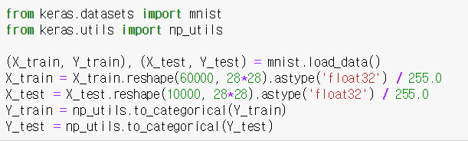
Load MNIST dataset
Load Data (Train Set / Test Set)
Data Preprocessing
One-hot encoding

Slide 3
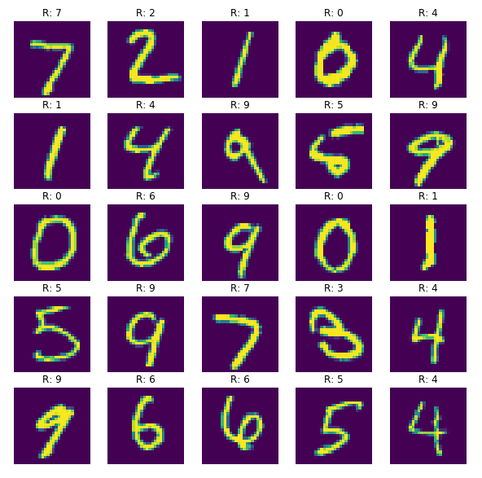
Load MNIST dataset

Slide 4
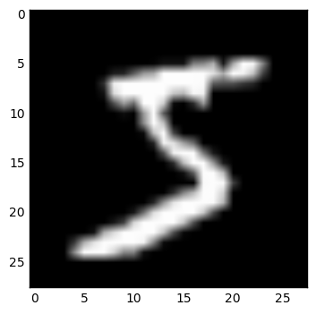
One hot encoding
[0, 1, 2, 3, 4, 5, … 9]
One hot encoding
(768, )
[[1, 0, 0, 0, 0, 0, 0, 0, 0, 0],
[0, 1, 0, 0, 0, 0, 0, 0, 0, 0],
…
[0, 0, 0, 0, 0, 0, 0, 0, 0, 1]]
(28, 28)

Slide 5
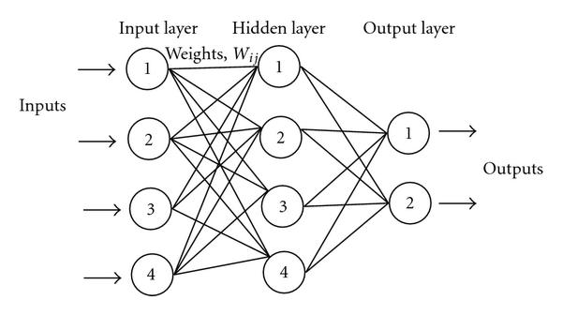
Create Model

Slide 6
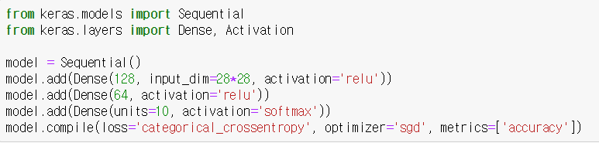
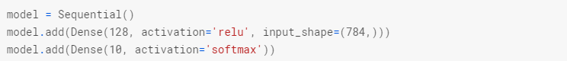
Create Model
Load Libraries
3-Layers model
Setting up the model learning process

Slide 7
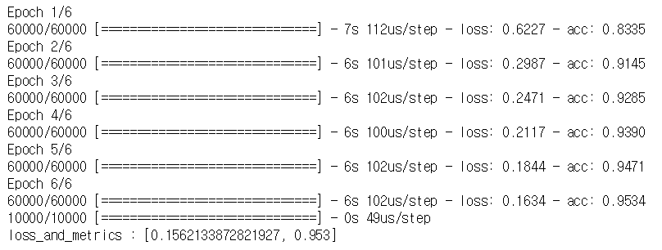
Train and Evaluate Model
(Training environment : Geforce GTX 1050)

Slide 8
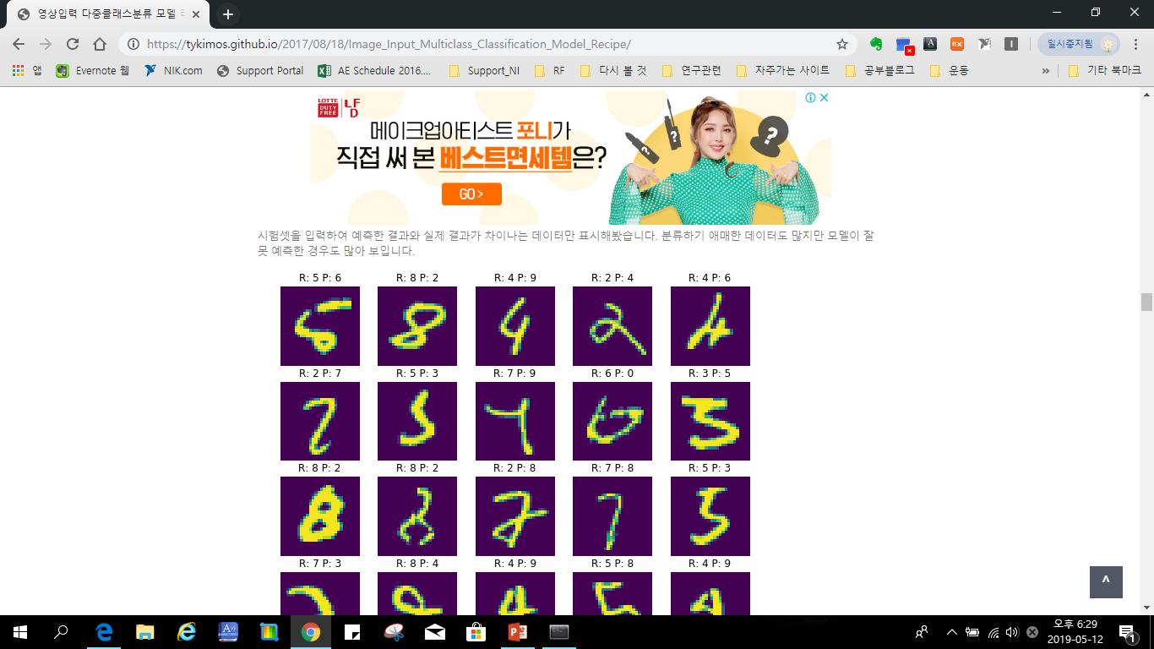
Conclusion
R : 8 P : 8
R : 4 P : 9
Correct
Incorrect

Slide 9
Q&A

